Slide 1
Predicting Alzheimer’s Disease At Low Cost Using Machine Learning
Presenters Names
Musfiquer Rhman – 17181103098
Farjana Rahaman – 16173103013
Khadija Akter – 17181103089
Md. Mintu Hossain – 17181103110
Umma Habiba Emu - 17181103106

Slide 2

Agenda
Introduction
Literature Review
Dataset
Data processing
Machine Learning Models
Hyperparameter Tuning
Ensemble Models
Results and Comparison
Conclusion

Slide 3
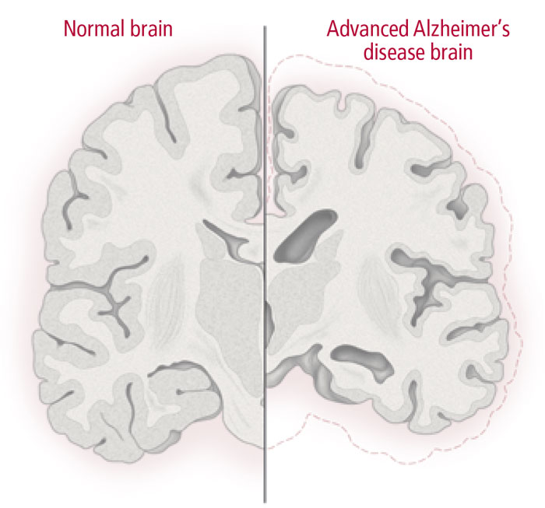
Introduction
Alzheimer's disease is a progressive neurological disorder.
By 2040, 71% of dementia patients will be from developing nations. [1]
Many people in those countries think the loss of memory is a typical aging problem.
The lack of diagnostic assessment, cost of diagnosis deters people from diagnosis of dementia. [2]
Some factors in dementia are Age, Gender, Low education level, Low social class, income, depression, head trauma, epilepsy, diabetes, stroke etc. [3-5]
Cognitive test can be used for early diagnosis.
Early confirmation can save life.

Slide 4

Literature Review
MRI / PET data, Biomarkers and longitudinal data analysis are the most common study topics in predicting Alzheimer's disease.
Gopi Battineni et al. [6] used MRI data to develop different ML models to predict dementia in the elderly.
Courtney Cocherane et al. [7] Instead of using MRI data, they used longitudinal lifestyle interventions to predict AD development.
XIN HONG et al. [8] focused on identifying time relative biomarkers associated with disease status.

Slide 5

Dataset
OASIS (Open Access Series of Imaging Studies) Dataset.
Variables:
Age
Gender
Years of Education
Socioeconomic Status
Mini-Mental State Examination score (MMSE)
Clinical Dementia Rating (CDR)
Estimated total intracranial volume (eTIV)
Normalize Whole Brain Volume (nWVB)
Atlas Scaling Factor (ASF)

Slide 6

Data preprocessing
Removed all the rows with empty data.
Used One-hot encoder to encoded all categorical variable.
Used 80% of the data for training our models and 20% for testing purpose.
In the first step, we included all the MRI data and longitudinal lifestyle data.
In the second step, we excluded all the MRI-related data.

Slide 7

Machine Learning Models
Used both classification and ensemble learner algorithms.
Started with several Machine learning models. But only selected the models that had more than 50% accuracy for tuning hyper-parameters.
The supervised learning module performs a ten-fold cross-validation and grid search over selected features for each model.
Applied the same procedure for both tests
Used best performing models to create an Ensemble model for both tests.

Slide 8
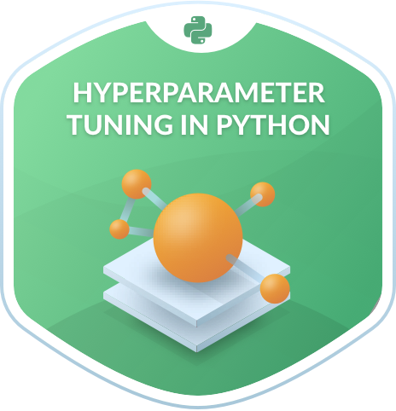
Hyperparameter Tuning
Hyperparameters define the architecture of the model.
The same machine learning model can require different constraints, weights, or learning rates to generalize different data patterns.
A grid of parameters and multiple values for each parameter was defined. Then GridSearchCV was used to find the best hyperparameters for the models.

Slide 9
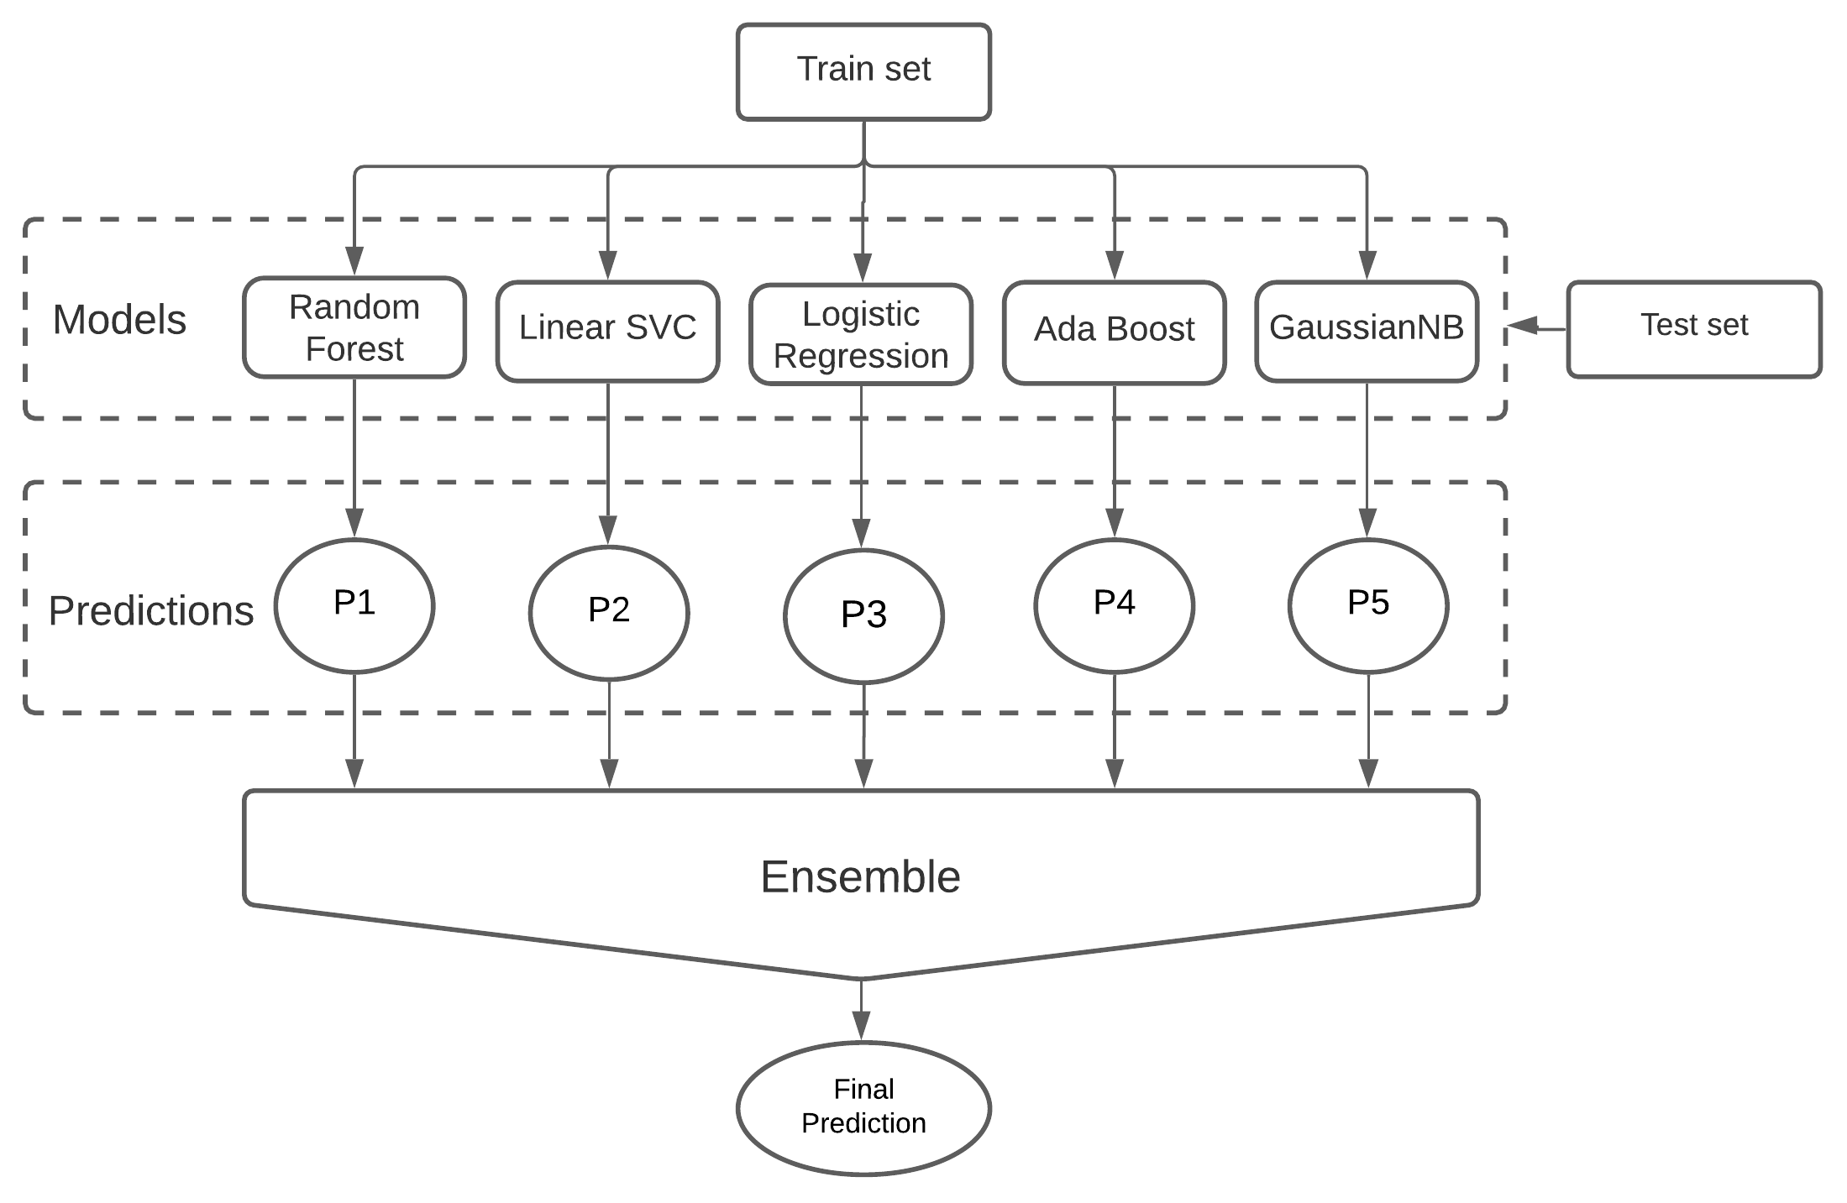
Ensemble Architecture
Ensemble Method is a machine learning technique where several Machine learning models are used to produce an optimal model
Ensemble algorithms perform better if there are significant differences or diversity among the models
The Soft voting classifier summed the probabilities of all the models and predicts the class with the highest probability.
For the model with MRI data, Random Forest, LinearSVC, Logistic regression, Ada Boost, and GaussianNB was used. For The non-MRI model, KNeighbours classifier was also added.

Slide 10
Results
MRI Models | Accuracy | Recall | Precision | F1 Score | AUC Score
Random Forest | 93.14% | 0.93 | 0.93 | 0.93 | 0.91
Linear SVC | 90.14% | 0.90 | 0.90 | 0.90 | 0.92
Logistic Regression | 94.37% | 0.94 | 0.94 | 0.94 | 0.97
Ada Boost | 96.07% | 0.96 | 0.96 | 0.96 | 0.95
GaussianNB | 86.00% | 0.86 | 0.86 | 0.86 | 0.90
Ensemble Model | 92.55% | 0.92 | 0.92 | 0.92 | 0.95
We compared the result in different scales like Accuracy, F1 score, Recall, Precision and AUC score.
MRI Results:
AdaBoost Classifier had the best Accuracy and a recall score from. Accuracy score of 96.07%, a Recall of 0.96.
Non-MRI Results:
Hybrid model had the Best result, an Accuracy score of 93.37%, a Recall of 0.93
Non MRI Models | Accuracy | Recall | Precision | F1 Score | AUC Score
Random Forest | 90.14% | 0.90 | 0.90 | 0.90 | 0.94
Linear SVC | 89.14% | 0.89 | 0.89 | 0.89 | 0.92
Logistic Regression | 88.73% | 0.89 | 0.89 | 0.89 | 0.94
Ada Boost | 89.14% | 0.89 | 0.89 | 0.89 | 0.94
GaussianNB | 88.73% | 0.89 | 0.89 | 0.89 | 0.93
KNeighbors | 83.10% | 0.83 | 0.83 | 0.83 | 0.90
Ensemble Model | 93.37% | 0.93 | 0.93 | 0.93 | 0.91

Slide 11
Results Analysis
No considerable gap in efficiency between our two experiments.
Accuracy Drop 3%, recall, precision and AUC score drop of 0.03.
Most of the models except for GaussianNB and KNeighbors performed better with MRI data.

Slide 12

Conclusion
The non-MRI methods can provide reliable results.
This will reduce the initial cost by a margin.
It can be used as a tool for raising awareness.
This method can be used reliably when there is a lack of diagnostic assessment or cannot afford an MRI test.
It is recommended to do an MRI test if possible for better detection and avoid the risk of false-negative prediction.
These results can be further improved by counting more factors related to AD, like depression, head trauma, epilepsy, diabetes, and stroke and similar factors.

Slide 13
REFERENCES
[1] C. P. Ferri, M. Prince, C. Brayne, H. Brodaty, L. Fratiglioni, M. Ganguli, K. Hall, K. Hasegawa, H. Hendrie, Y. Huang, A. Jorm, C. Mathers, P. R. Menezes, E. Rimmer, and M. Scazufca, “Global prevalence of dementia: a Delphi consensus study,” The Lancet, vol. 366, no. 9503, pp. 2112–2117, 2005.
[2] I. Raicher, M. M. Shimizu, D. Y. Takahashi, R. Nitrini, and P. Caramelli, “Alzheimer's disease diagnosis disclosure in Brazil: a survey of specialized physicians' current practice and attitudes,” International Psychogeriatrics, vol. 20, no. 03, 2007.
[3] Raicher, Irina, Marta Maria Shimizu, Daniel Yasumasa Takahashi, Ricardo Nitrini, and Paulo Caramelli. "Alzheimer's disease diagnosis disclosure in Brazil: a survey of specialized physicians' current practice and attitudes." International Psychogeriatrics, Vol 20, no. 3, page 471, 2008.
[5] A. R. Borenstein, C. I. Copenhaver, and J. A. Mortimer, “Early-Life Risk Factors for Alzheimer Disease,” Alzheimer Disease &amp; Associated Disorders, vol. 20, no. 1, pp. 63–72, 2006.
[6] M. A. Lopes, S. R. Hototian, S. E. Bustamante, D. Azevedo, M. Tatsch, M. C. Bazzarella, J. Litvoc, and C. M. Bottino, “Prevalence of cognitive and functional impairment in a community sample in Ribeirão Preto, Brazil,” International Journal of Geriatric Psychiatry, vol. 22, no. 8, pp. 770–776, 2007.
[6] G. Battineni, N. Chintalapudi, F. Amenta, and E. Traini, “A Comprehensive Machine-Learning Model Applied to Magnetic Resonance Imaging (MRI) to Predict Alzheimer’s Disease (AD) in Older Subjects,” Journal of Clinical Medicine, vol. 9, no. 7, p. 2146, 2020.
[7] Courtney Cochrane, David Castineira1, Nisreen Shiban, Pavlos Protopapas, Application of Machine Learning to Predict the Risk of Alzheimer's Disease: An Accurate and Practical Solution for Early Diagnostics. arXiv:2006.08702v1 [q-bio.QM] 2 Jun 2020.
[8] X. Hong, R. Lin, C. Yang, N. Zeng, C. Cai, J. Gou, and J. Yang, “Predicting Alzheimer’s Disease Using LSTM,” IEEE Access, vol. 7, pp. 80893–80901, 2019.

Slide 14
THANK YOU

